Slide 1
Verilog Simulation & Debugging Tools
數位電路實驗
TA: 吳柏辰
Author: Trumen

Slide 2
Outline
Environment Setup
NC-Verilog
nLint
nWave
Verdi

Slide 3
Environment Setup

Slide 4
Login to the Linux Server
Many EDA tools are provided only for the Linux OS.
So we have to use software like PuTTY/PieTTY/MobaXterm on our local computer to login to the linux server and use the EDA tools on it.

Slide 5
NTUEE Linux Servers
IC Design Lab (TA:邱茂菱) http://cad.ee.ntu.edu.tw/
Server list
IP | NAME | TYPE | CPU | CPU CLOCK | MEMORY | OS
140.112.20.59 | cad16 | IBM X3400 | Intel Xeon 64 | 2.4 GHz * 16 | 100 G | RHEL 5
140.112.20.60 | cad17 | IBM X3550 | Intel Xeon 64 | 2.4 GHz * 16 | 20 G | RHEL 5
… | … | … | … | … | … | …
140.112.20.85 | cad42 | IBM X3500 | Intel Xeon 64 | 2 GHz * 24 | 32 G | CentOS 5

Slide 6
X Window System
X Window System (X11, X, and sometimes informally X-Windows) is a windowing system for bitmap displays, common on UNIX-like (ex: Linux) operating systems.
Microsoft Windows is not shipped with support for X, but many third-party implementations exist, as free and open source software such as Cygwin/X, and proprietary products such as Xming.

Slide 7

Introduction to MobaXterm (1/2)
MobaXterm is free software that can be installed onto your local Windows or Mac computer which provides a graphical user interface and a command line shell for the server.
Official Website http://mobaxterm.mobatek.net/

Slide 8
Introduction to MobaXterm (2/2)
MobaXterm provides useful features for developers:
Multitab terminal with embedded Unix commands (ls, cd, ...).
Embedded X11 server for easily exporting your Linux display.
Passwords management for SSH, SFTP, etc (on demand password saving).
…

Slide 9
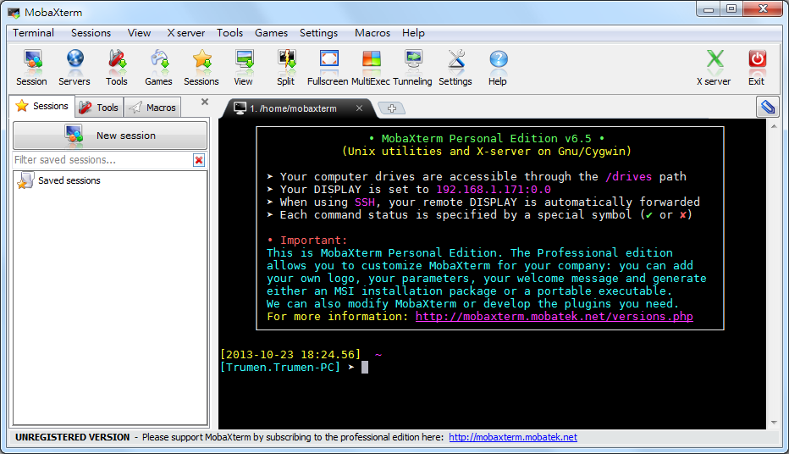
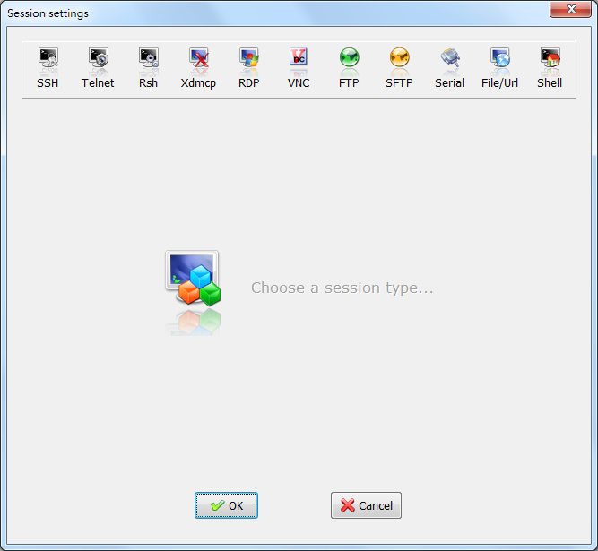
Session Settings
Click the Session button and specify which session you want. Usually this will be SSH. For that click SSH.
1
2

Slide 10
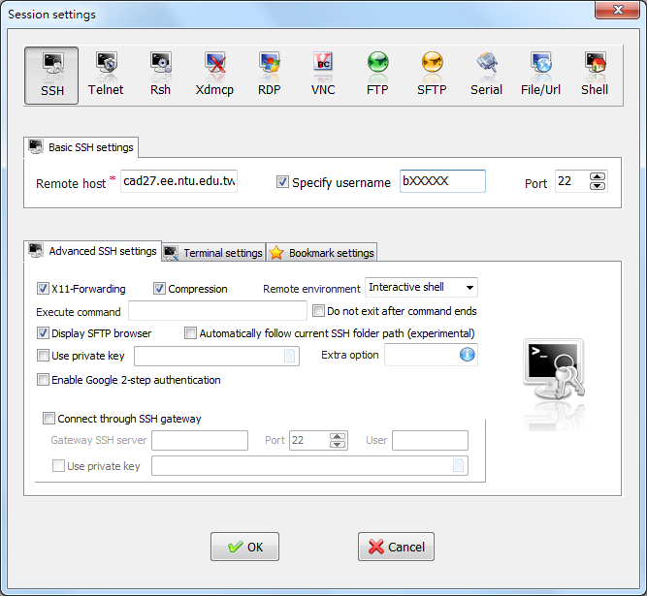
1
2
3

Slide 11
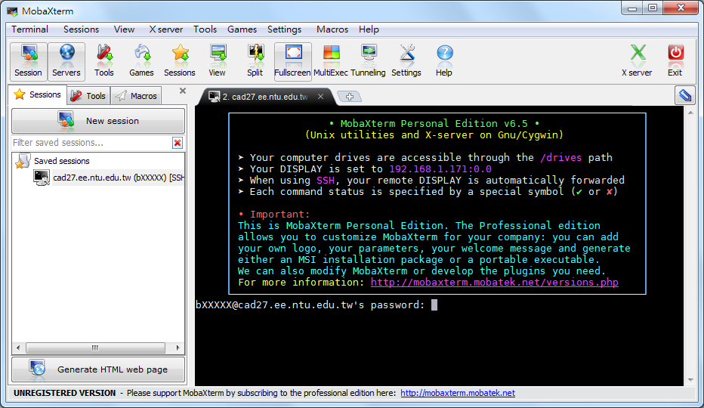
1 (double-click)
2

Slide 12
Command Line Shell
We can also use the command line shell to login to the server.
ssh bXXXXX@cad27.ee.ntu.edu.tw [-p YYYYY]
bXXXXX: your usesr name
YYYYY: port number
here -p 22 is redundant because 22 is the default port number.

Slide 13
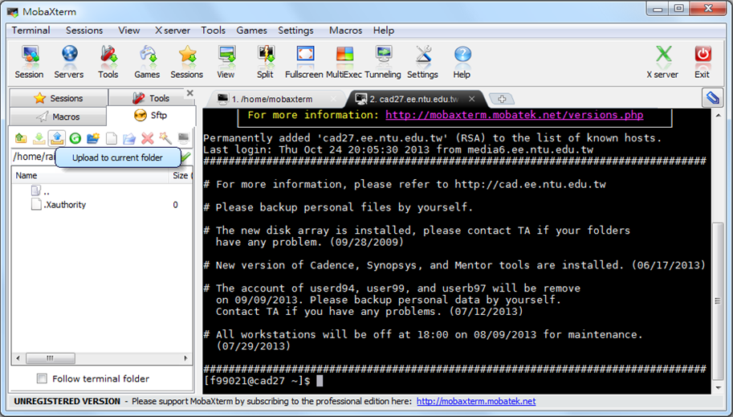
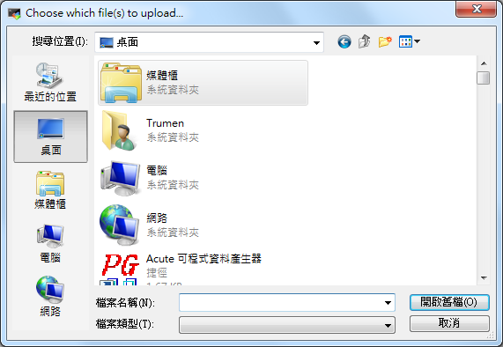
Upload Files (1/2)
Uploading files fom your local PC to the server.
1
2
3. Choose which file(s) to upload

Slide 14
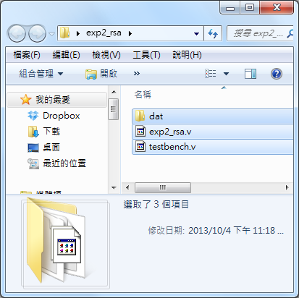
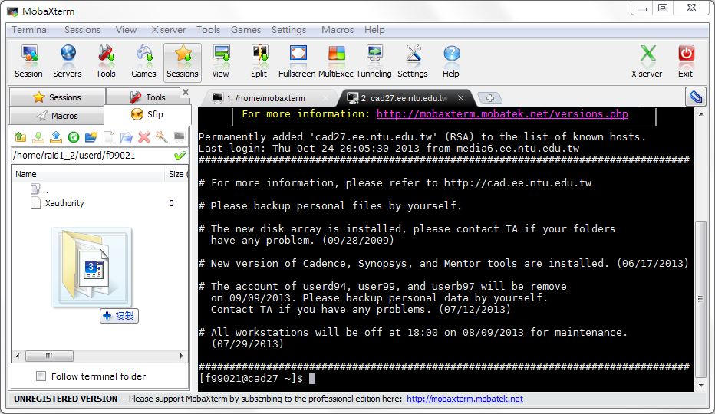
Upload Files (2/2)
Moving and copying files by using the drag-and-drop.
1
2

Slide 15
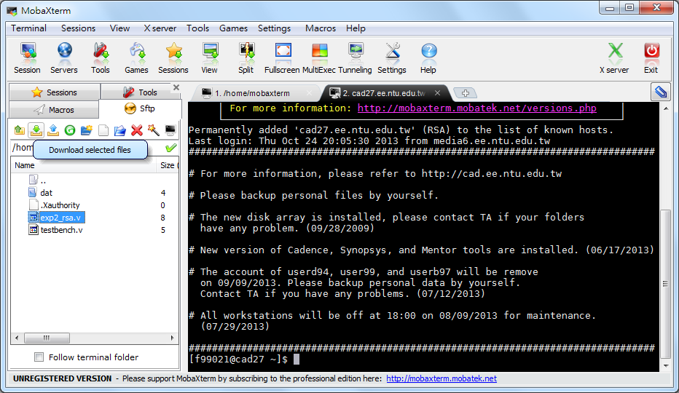
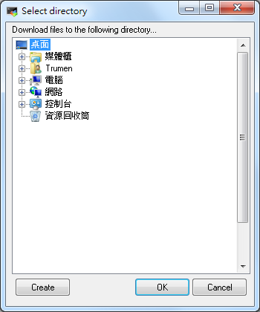
Download Files (1/2)
Downloading files from the server to local PC.
2
3. Select directory
1

Slide 16
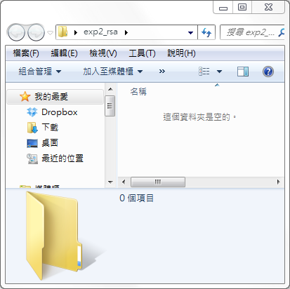
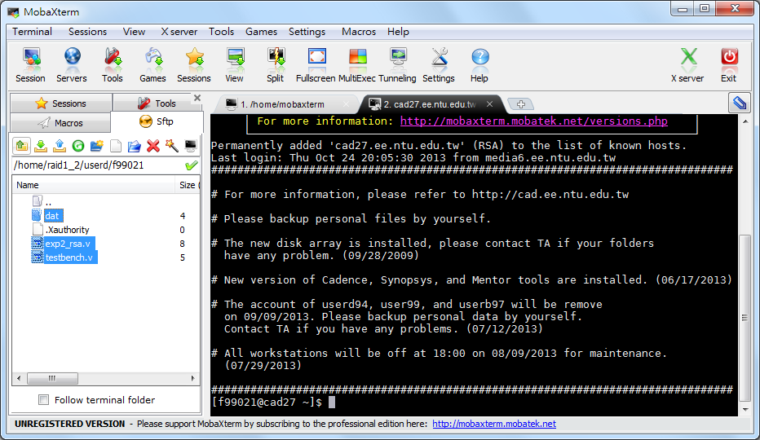
Download Files (2/2)
Moving and copying files by using the drag-and-drop.
2
1

Slide 17
NC-Verilog

Slide 18
Introduction to NC-Verilog
The Cadence® NC-Verilog® simulator is a Verilog digital logic simulator.
We can use NC-Verilog to
Compiles the Verilog source files.
Elaborates the design and generates a simulation snapshot.
Simulates the snapshot.

Slide 19
Before Using NC-Verilog
Source the environment settings of CAD tools.
If you try entering the command "ncverilog" but it turns out "command not found," it means there's something wrong with the "*.cshrc" file or the software license is out of date.
source ~cvsd/cvsd.cshrc
Notes:
有些server輸入"source ~cvsd/cvsd.cshrc"後會出現command not found
這很有可能是false alarm，先輸入ncverilog檢查是否能夠使用
如果可以使用的話就沒問題了

Slide 20
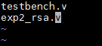
Running Verilog (1/2)
Run the Verilog simulation:
Another choice of running Verilog simulation:
ncverilog testbench.v exp2.rsa.v +access+r
ncverilog -f exp2_rsa.f +access+r
In exp2_rsa.f

Slide 21
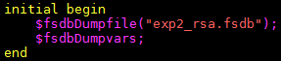
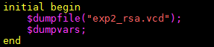
Running Verilog (2/2)
"+access+r" is added to enable waveform file dumping.
*.fsdb has smaller file size than *.vcd. But $fsdbDumpfile cannot work without sourcing verdi.cshrc.
In testbench.v, line 69~72
or

Slide 22
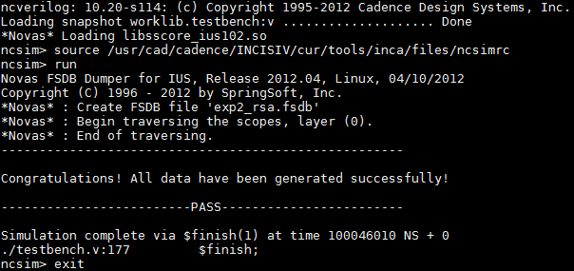
Simulation Results
Check the simulation result to see if the Verilog design is finished correctly.

Slide 23
nLint

Slide 24
Introduction to nLint
nLint is a comprehensive HDL design rule checker fully integrated with the Debussy debugging system (Developed by SpringSoft).
We can use nLint to check the coding style of our design and if it is synthesizable.

Slide 25
Before Using nLint
Source the environment settings of CAD tools.
To avoid the warning *WARN* Failed to check out license. occurs when starting nLint, please type the following command:
source ~cvsd/verdi.cshrc
setenv LM_LICENSE_FILE '26585@lsntu:26585@lsncku'

Slide 26
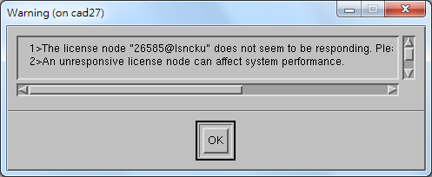
Start nLint
Type the following command:
The token "&" enable you to use the terminal while nLint is running in the background.
nLint -gui &
Just ignore this warning.

Slide 27
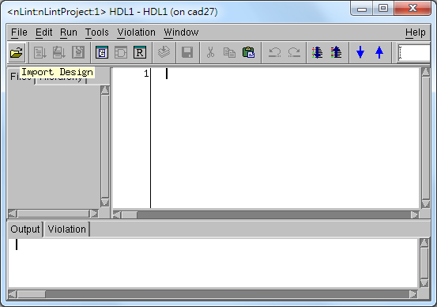
Specify the Design File
1

Slide 28
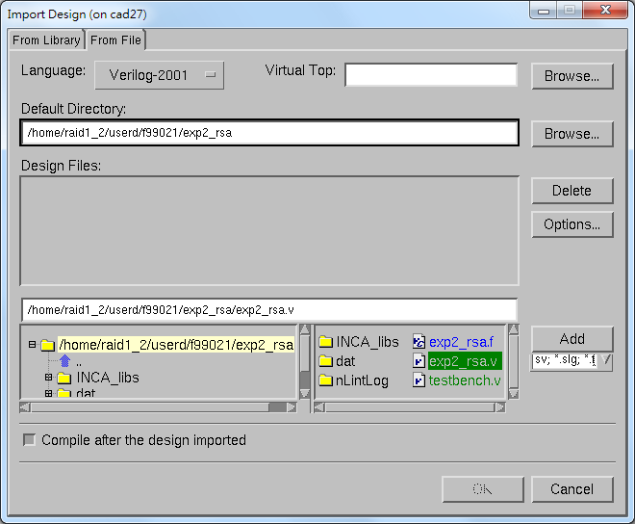
1
2
4
3
5

Slide 29
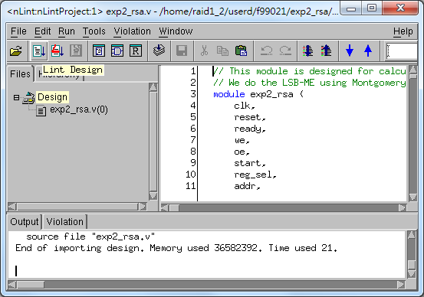
Start Checking
1

Slide 30
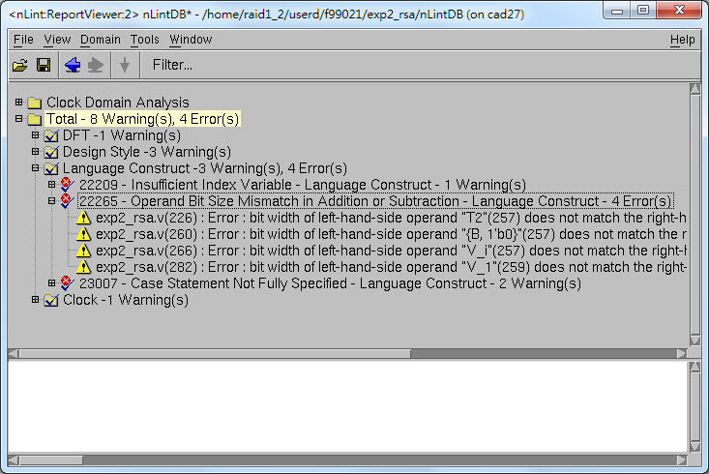
Not all the warnings or errors are valuable.

Slide 31
nWave

Slide 32
Introduction to nWave
nWave is one of the best waveform (*.vcd or *.fsdb) viewer.
We can debug easily by checking the waveform file dumped during simulation.

Slide 33
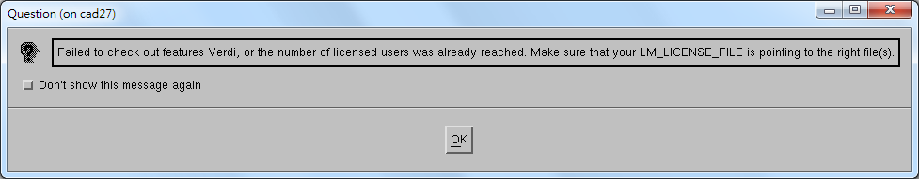
Before Using nWave
Source the environment settings of CAD tools.
To avoid the Verdi warning window occurs, please type the following command:
source ~cvsd/verdi.cshrc
setenv LM_LICENSE_FILE '26585@lsntu:26585@lsncku'

Slide 34
Start nWave
Type the following command:
Also, the token "&" enable you to use the terminal while Verdi is running in the background.
nWave &
Just ignore this warning.

Slide 35
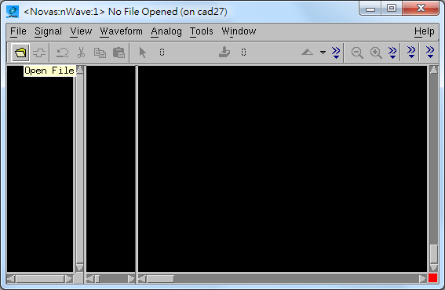
Open the FSDB File
1

Slide 36
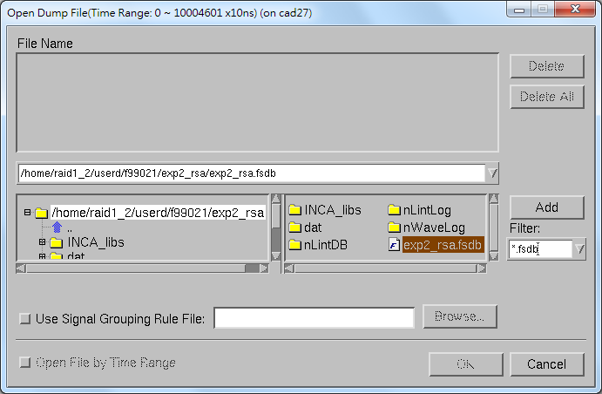
2
1
3

Slide 37
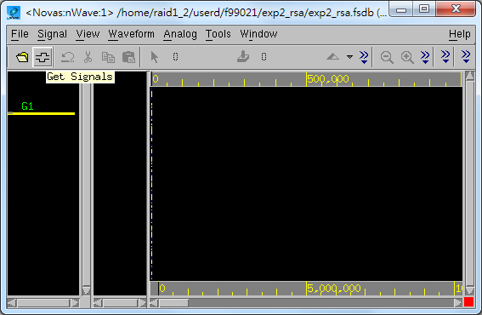
Choose Signals
1

Slide 38
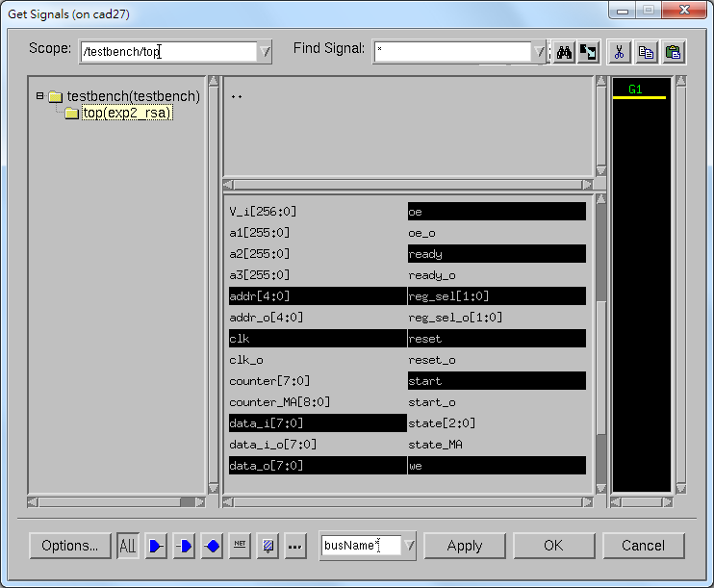
1
2
Choose signals we are interested in.
3
4

Slide 39
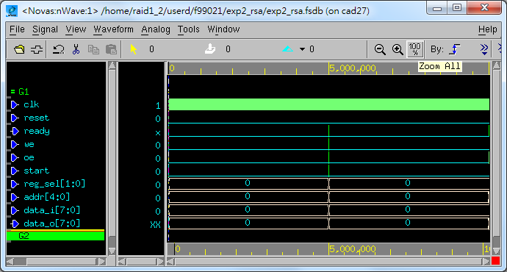
Browse the Whole Waveform
1

Slide 40
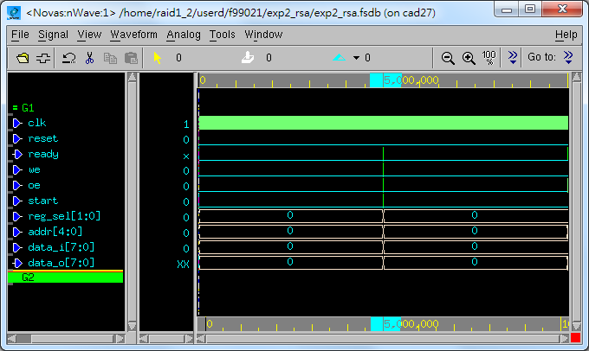
Browse the Specified Interval
press & drag

Slide 41
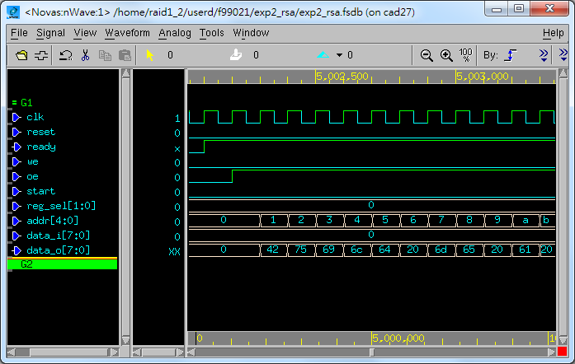

Slide 42
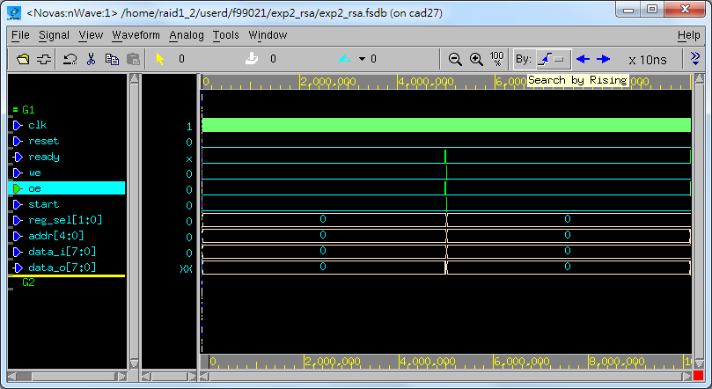
Search for Specified Signal
4,5,…
2
3
1

Slide 43
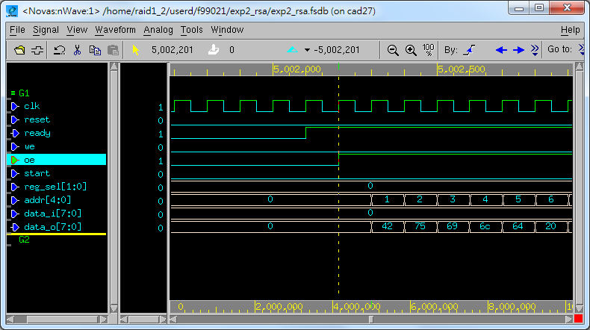
Jump to the cursor position (Used when we are lost)
cursor position
(Search by rising oe)

Slide 44
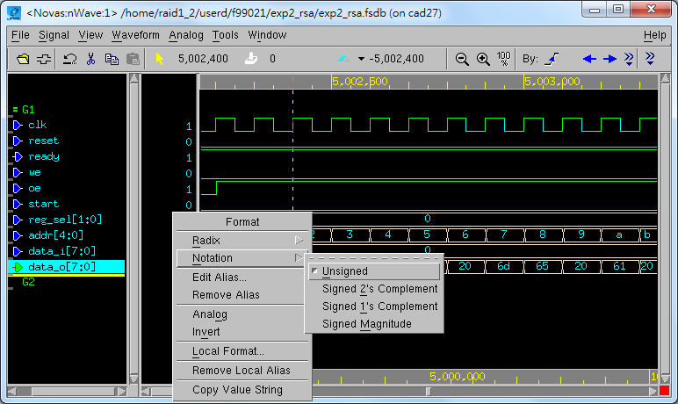

Change Sign Representation
2
3
1

Slide 45
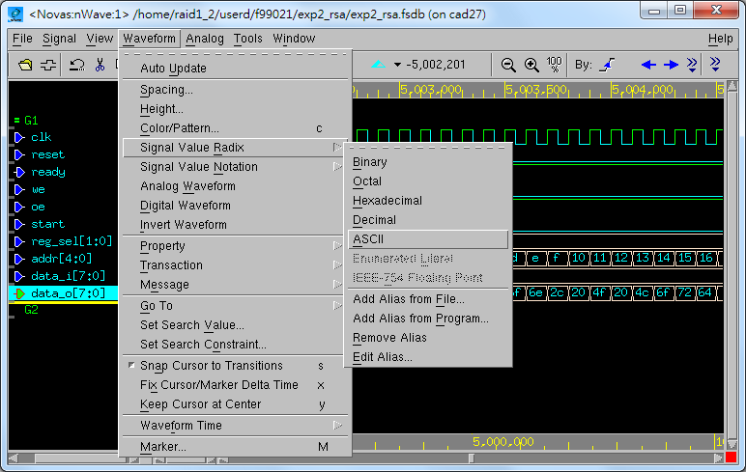
Change Radix Representation
2
3
4
1

Slide 46
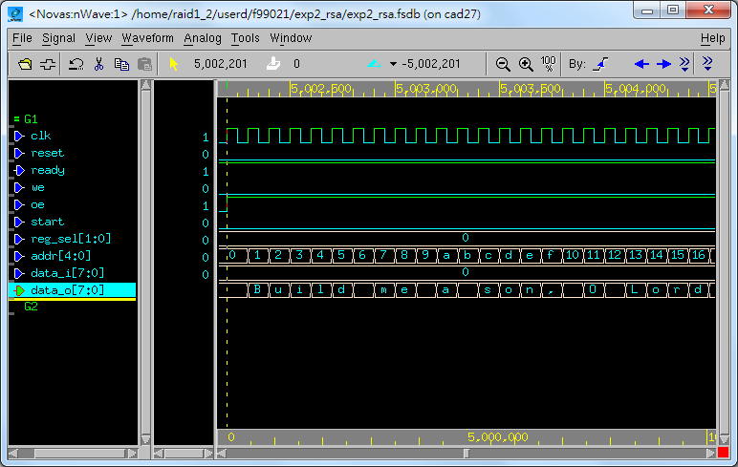

Slide 47
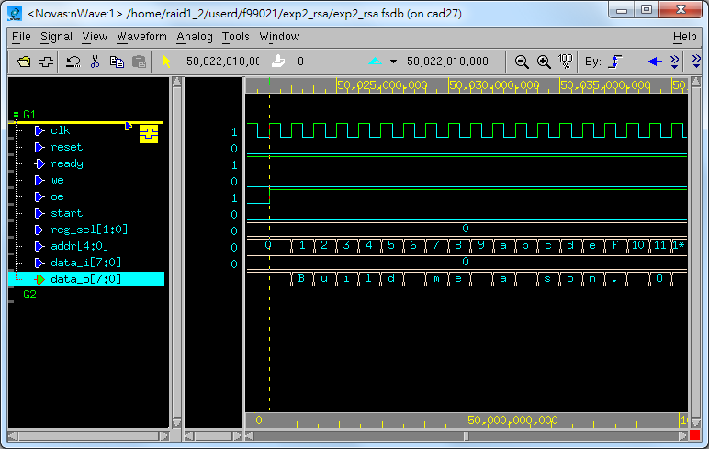
Change Signal Position
2
Press middle mouse button,
drag and then drop.
1

Slide 48
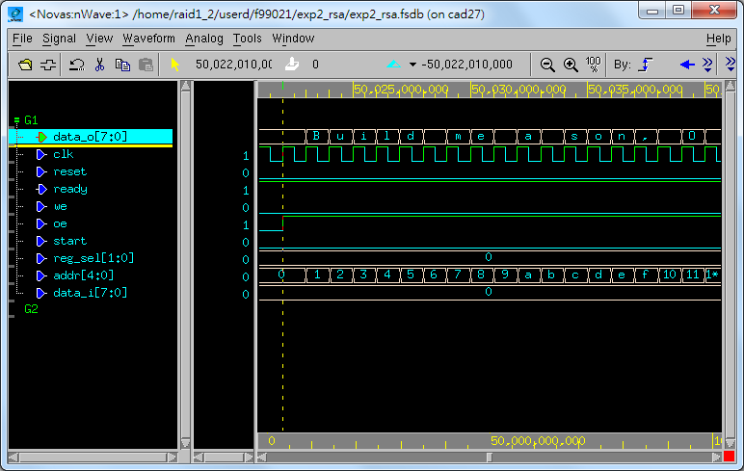

Slide 49
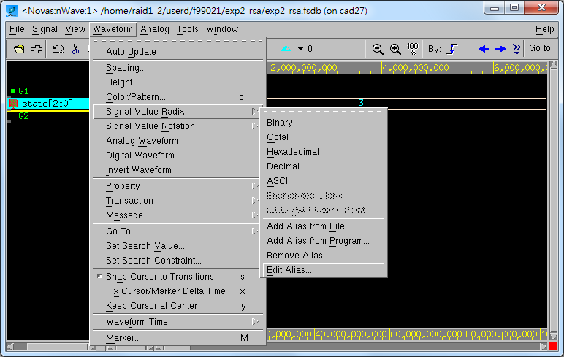
Signal Aliasing
2
1
3
4

Slide 50
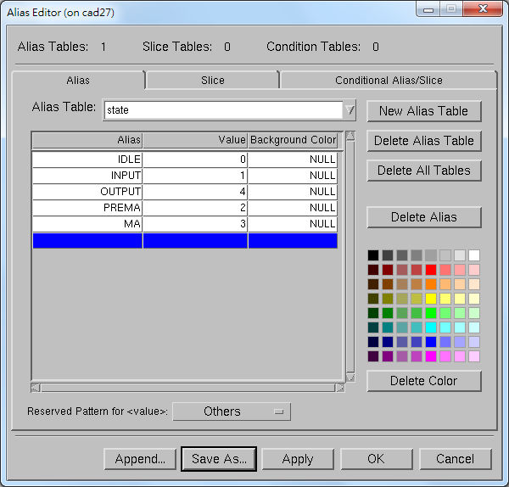
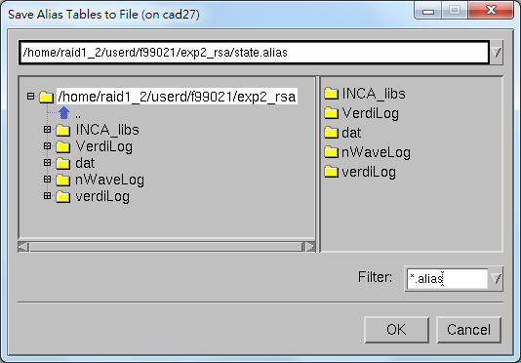
1
4
2
Note that signal aliasing is a strict one-to-one correspondence so the value represented in the viewer must exactly represent what format your filter expects. (e.g., binary, hexadecimal)
5
3
6

Slide 51
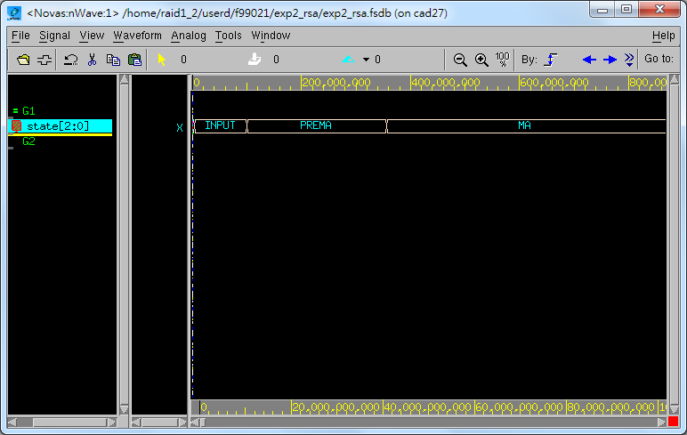

Slide 52
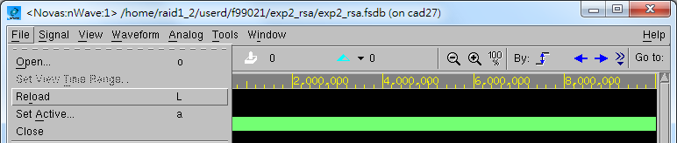
Reload the Waveform
Remember to reload the waveform whenever finishing another Verilog simulation.
1

Slide 53
Verdi

Slide 54
Introduction to Verdi
The Verdi Automated Debug System is an advanced open platform for debugging digital designs with powerful technology that helps you:
Comprehend complex and unfamiliar design behavior.
Automate difficult and tedious debug processes.
Unify diverse and complicated design environments.

Slide 55
Basic Function (1/2)
nTrace
A source code viewer and analyzer that operates on the knowledge database (KDB) to display the design hierarchy and source code (Verilog, VHDL, SysmVerilog, SystemC, PSL, OVA, mixed) for selected design blocks.
The main window of Verdi.

Slide 56
Basic Function (2/2)
nWave
A state-of-the-art graphical waveform viewer and analyzer that is fully integrated with Verdi's source code, schematic, and flow views.
nSchema
A schematic viewer and analyzer that generates interactive debug-specific logic diagrams showing the structure of selected portions of a design.
These two tools can be opened through nTrace.

Slide 57

Before Using Verdi
Source the environment settings of CAD tools.
To avoid the Verdi warning window occurs, please type the following command:
source ~cvsd/verdi.cshrc
setenv LM_LICENSE_FILE '26585@lsntu:26585@lsncku'

Slide 58
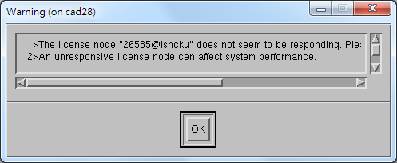
Start Verdi
Type the following command:
Also, the token "&" enable you to use the terminal while Verdi is running in the background.
verdi &
Just ignore this warning.

Slide 59
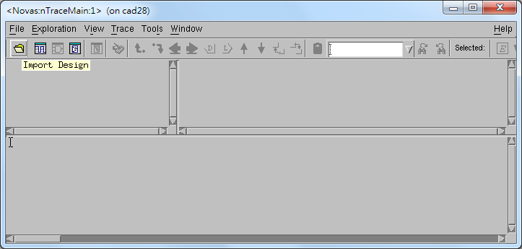
nTrace
1

Slide 60
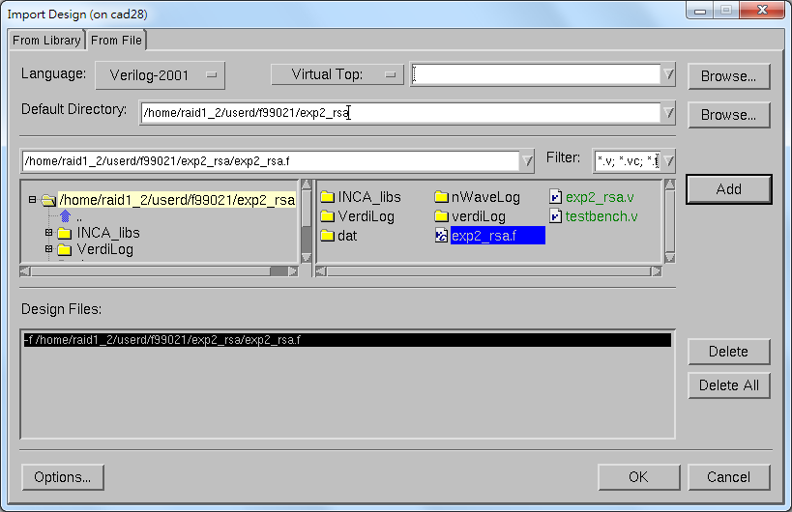
1
2
4
3
5

Slide 61
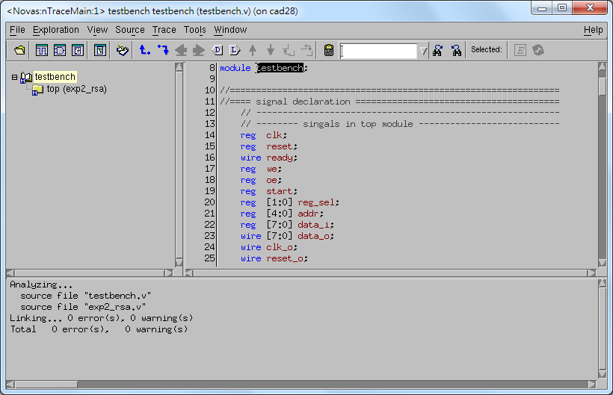
1 (double-click)
Netlist Code
Window
Hierarchical
Browser
Message
Window

Slide 62
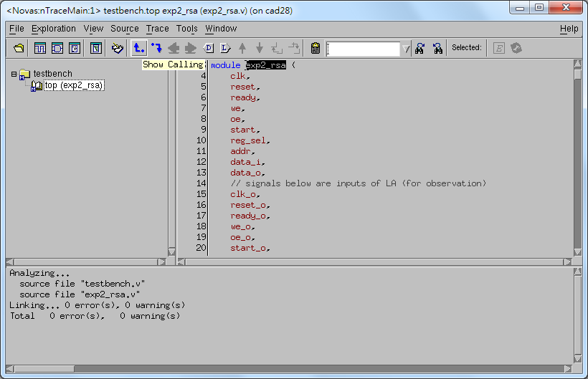
1
1
double-click
Notes:
同號表示兩者等意
like "Go to Declaration" in visual studio

Slide 63
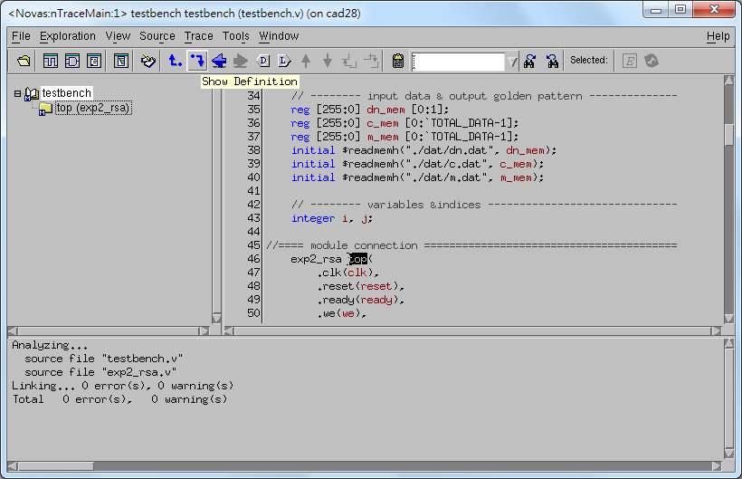
1
1
double-click
Notes:
同號表示兩者等意
like "Go to Definition" in visual studio

Slide 64
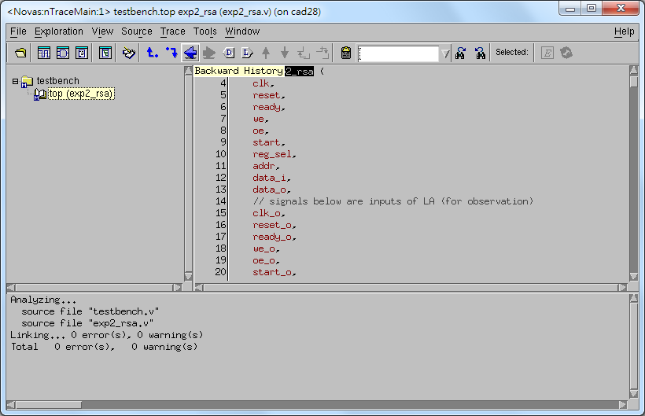
1

Slide 65

1

Slide 66
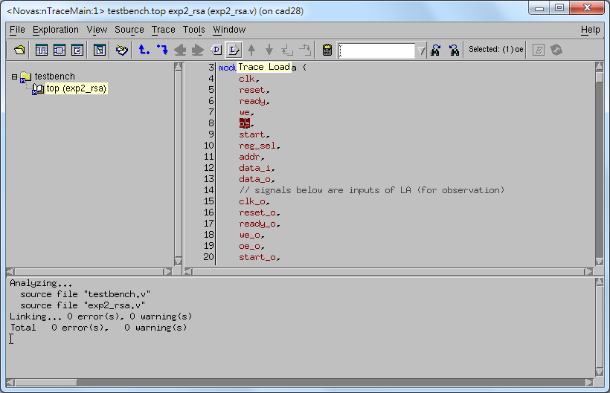
2
1

Slide 67
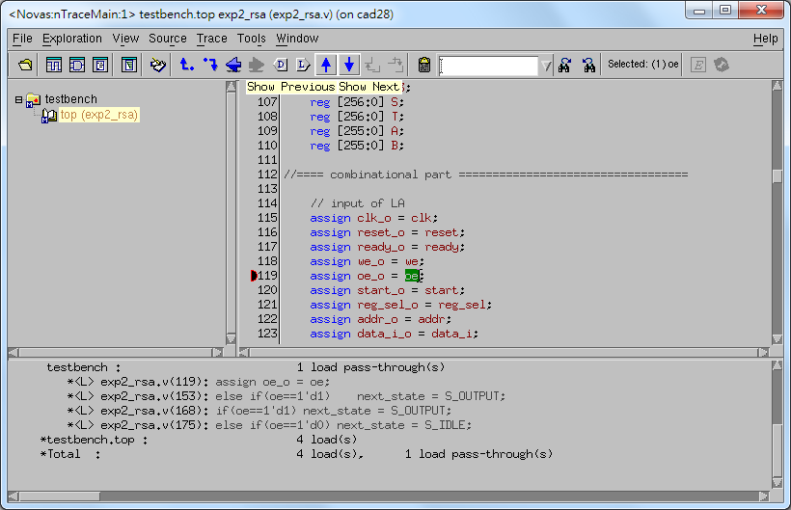

Slide 68

2
1

Slide 69


Slide 70

nSchema
1

Slide 71

Push View In
1 (double-click)

Slide 72

1

Slide 74

1 (right-click)
2

Slide 75

1 (right-click)
2

Slide 76


Slide 77

nWave
1

Slide 78


1
2
1
3

Slide 79


1
Press middle mouse button,
drag and then drop.

Slide 80


Slide 81

1
Ctrl + C

Slide 82

1 (right-click)
2

Slide 83


Slide 84

1
2

Slide 85

1

Slide 86

1

Slide 87


Slide 88


Slide 89
The End.
Any question?

Slide 90
Reference
"MobaXterm User Manual“ by The Centre for eResearch, University of Auckand.
"Cadence NC-Verilog Simulator Tutorial“ by Cadence
"Quick Start: an nLint Tutorial" by NOVAS
"Introduction to Verdi" by Abel Hu
"Verdi³ datasheet" by Synopsys

